Slide 1
Juliya Mollen
230033
DESIGN &
PRODUCTION
[photo]
CMGT Intake
2023-24

Slide 2

How To Use
This Template
As an applicant at Breda University of Applied Sciences for the Creative Media and Games Technologies (CMGT) undergraduate programme you are required to provide evidence that demonstrates your current level and other factors required for pre-selection assessment and potential interview. The course is taught in English, so all submissions must be in English.
With the evidence you present here teachers should obtain a clear and comprehensive overview of your current technical skill and the progress you have made as an aspiring game developer.
This presentation is intended to provide you with a well-structured and organised format for doing this effectively. Please follow the directions on each slide to help ensure you supply the information required. You should use and update the presentation attached to the assignment in Teams (do not delete or replace this as this breaks the link). Please do not spend time formatting the style of the presentation. Only insert extra slides where it says you can otherwise use the space, word count and font size provided. Also be sure to add your details where requested (for example on the first slide).
Make sure to read the assignment and instructions on Teams carefully. Evidence needs to be provided in this presentation as well as during the interview (if applicable). The grading rubric can be found on Teams.

Slide 3
Section A
A
Assignment

Slide 4
A
(A1) Education information
A
Please state your current education level
(Mbo 4, Game Art at Sint-Lucas)
If you are studying/have studied at higher/college level, please state the college name, course and diploma/degree awarded
No
(only for Dutch students. If you are uncertain the answer is no) Have you studied at a Technasium? /(no)

Slide 5
A
(A2) Design and Production Assignment - Creating a game
Rules
Game must be a side scrolling platformer.
You can only use your own art, art provided through a tutorial or art from Kenney.nl
Marketplace assets are not allowed.
If you use a tutorial, clearly reference it and build at least one new feature not part of the tutorial.
Provide a short description of your game
Out run the past .
A fun side scroller platformer where you need go to the flag as quick as possible. Can you improve your time or find the best route to achieve a better time?
I made a playlist of tutorials I used to make this game
https://youtube.com/playlist?list=PL4vimhMaVpMKV2AOJI1g4C6j_dsOf0hJw
Provide 3 to 5 diagrams of ideas for your game
I added my diagrams in the next 3 slides to make sure that no detail gets lost.

Slide 6
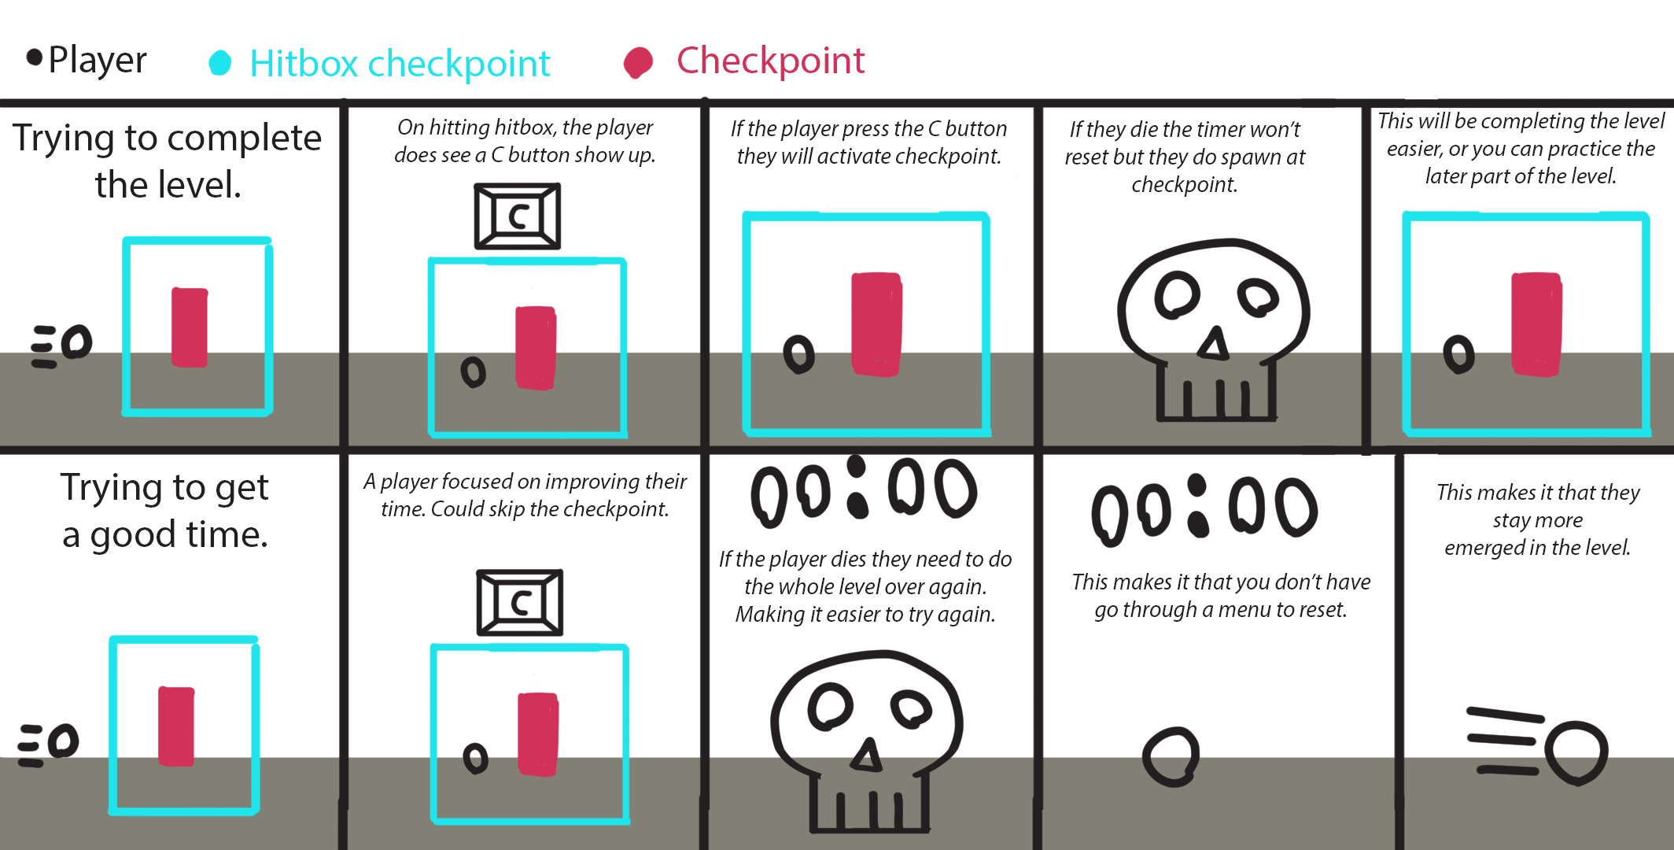
A
Diagram 1 checkpoint system
I made this diagram to show how I want my checkpoint system to work.

Slide 7
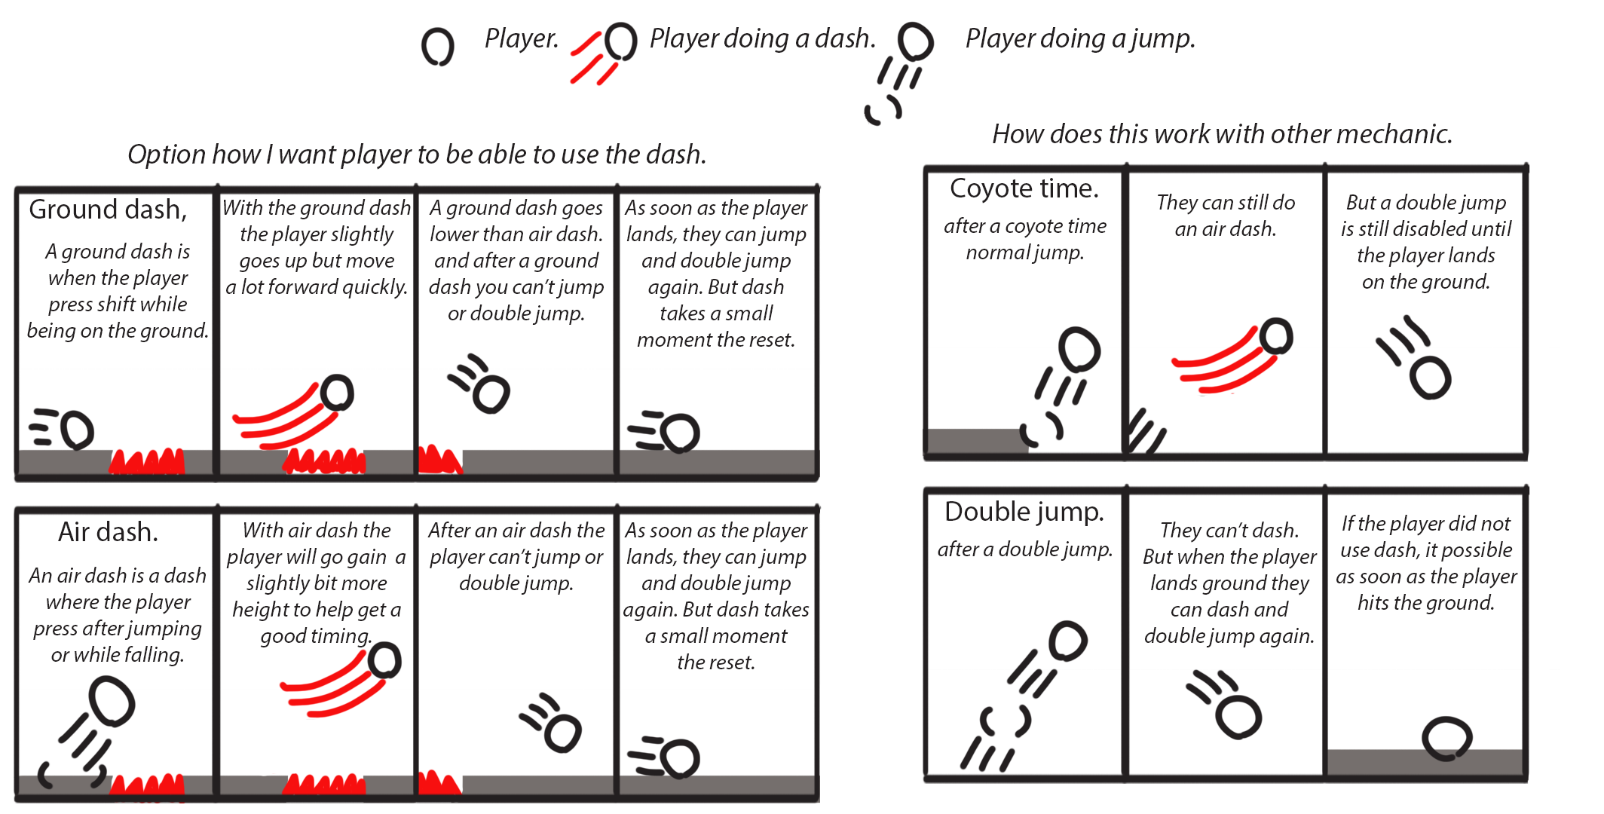
A
Diagram 2 Dash
I made this diagram to show how I want my dash to work
and how I want it to interact with other mechanics

Slide 8
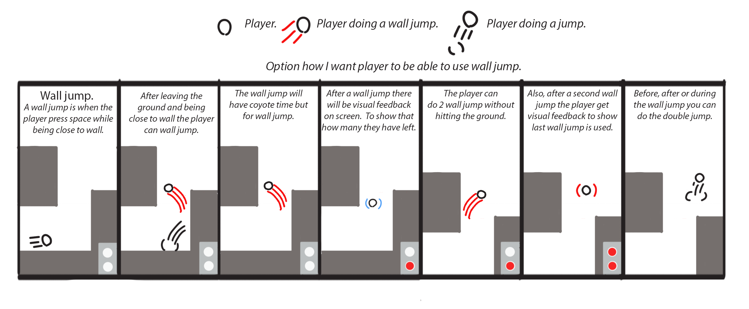
A
Diagram 3 Wall jump
I made this diagram to show how I want my wall jump to work.

Slide 9
A
(A3) Design and Production Assignment - Creating a game
Describe 3 important design decisions and your justification for them.
A classmate of mine said she found the character a little bit floaty. And suggested a dash after looking in to making a dash I decided to look for a less complicated solution. I changed the level design to go less up and more forward. This made it feel less floaty. (and I learned that players know what the problems are, but don’t always have good solutions)
I made checkpoint optional so that I can make system where player is more active in the game less in a menu when playing the game. With as goal to immerse the player.
Provide 1-2 short videos showing your game and some of its best parts.
When you embed an mp4 (video) here, keep it short (no longer than 30 seconds). Instructions on doing this can be found here. Add one sentence per video/image describing what the video/image is about.

Slide 10
A
(A4) Design and Production Assignment - Testing and Iterating
Provide short video(s) or picture(s) of play-tester(s) of the intended target audience playing your game.
When you embed an mp4 (video) here, keep it short (no longer than 30 seconds). Instructions on doing this can be found here. Add one sentence per video/image describing what the video/image is about.
Write down your 2-3 most important test results.
Describe how you iterated on your game design and explain why the redesign improves the game experience.
I made a 3D model for the spike in the game because a few people jump on the red block that I used as spikes.
Floaty feel result

Slide 11
A
(A5) Design and Production Assignment - Testing and Iterating
Provide 2-3 examples of before and after (short) videos on changes you made based on the test results.
When you embed an mp4 (video) here, keep it short (no longer than 30 seconds). Instructions on doing this can be found here. Add one sentence per video/image describing what the video/image is about.

Slide 12
A
(A6) Relevant Portfolio, Skills & Knowledge
Please use this space to add examples of your best work from your portfolio, study or work history that are relevant to game development or the discipline you are applying for.
You may also include:
A list of skills & knowledge relevant to game development or becoming a successful student.
Activities you currently do to prepare yourself for our study & future in games development.
Links to examples of your work or portfolio website (but most important information should be in this presentation).
Insert up to 5 slides here. Images are allowed with a maximum 150-200 words per slide.

Slide 13
A
Paper prototype horror game (Prototyping)

Slide 14
A
Warworks: Notebook agile game production (system design)

Slide 15
A
Warworks (focus on teamwork)

Slide 16
A
Level design Exo (teamwork in a big team of 30+ people)

Slide 17
A
Untitled card game: A working title (personal project)

Slide 18
End of Presentation
Thank you for participating in the intake for
CMGT Games @ Breda University of Applied Sciences

